Slide 1

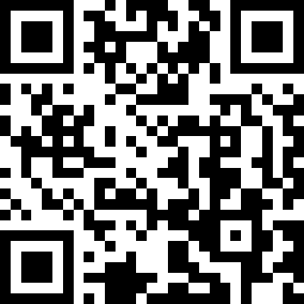





PEER-REVIEWED INTERNATIONAL SYMPOSIUM
1–2 April 2027
Sessions
S1
Segmentation & Registration
UMC Utrecht & Princess Máxima Center · Utrecht, the Netherlands
S2
Reconstruction & Synthesis
S3
Foundation Models, Text, Explainability & Uncertainty
Abstract submission closes
1 December 2026
S4
Dose & Adaptive Workflows
Six 90-min sessions · Invited state-of-the-art talks (30 min) · Proffered papers (9+3 min) A cross-disciplinary keynote each day · Double-blind review
S5
Clinical Predictions & Outcomes
S6
Implementation, QA & Ethics
https://AIinRT.org
— Call for Abstracts opens on 1 September
Organized by
In collaboration with
Notes:
AIinRT 2027 save-the-date / announcement slide for the workshop.

